Slide 1

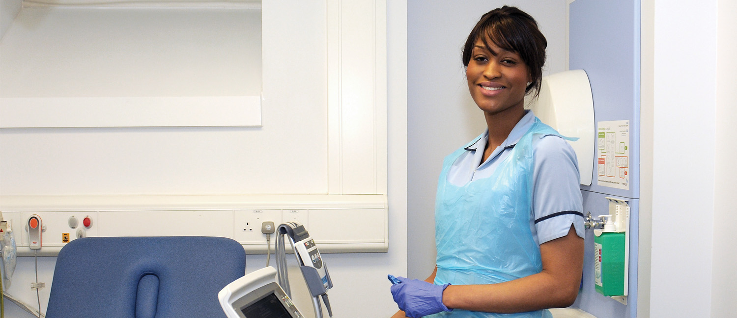

Horus ePortfolio for
Foundation
Familiarisation for foundation doctors - webinar
https://horus.hee.nhs.uk
https://supporthorus.hee.nhs.uk
** Your microphone will remain on mute throughout the webinar **

Slide 2

Introductions
Webinar lead
Kata Várnai
Project Manager (HEE e-portfolios)
Webinar support
Ben Aspinall and Jack Grice
Horus ePortfolio Administrators
Enquiries.Horus@hee.nhs.uk

Slide 3
Agenda
Webinar style
Questions and answers
Glossary
Intended audience
Webinar aims
Setting expectations
Live demonstration
Functionality on its way
Accounts and access
Archiving of data from NES ePortfolio (relevant to those who have used the NES ePortfolio for foundation)
Support
Feedback
Important links
Enquiries.Horus@hee.nhs.uk

Slide 4
Webinar Style
Mixture of presentation and demonstration
All attendees muted throughout
You can ask questions by typing into the ‘Questions’ box
The webinar is being recorded
Will be available on open-access Support Site
Enquiries.Horus@hee.nhs.uk

Slide 5
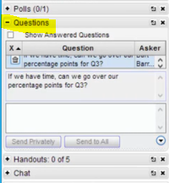
Questions and Answers
Ask questions by typing in the ‘Questions’ box
Jack and Ben will answer relevant
questions here
- There are a lot of you here, so please bear with us as we work our way through your questions. We won’t have time to answer all your questions. Please keep them relevant to the webinar.
Any technical questions should be directed to the Horus Helpdesk – this includes if you are having login issues. We will not deal with individual technical issues during this webinar.
Enquiries.Horus@hee.nhs.uk

Slide 6
Q&A follow up
I will stop periodically to answer some your frequently asked questions out loud
Any relevant questions we are not able to answer will be answered following the webinar – please forward your question to enquiries.horus@hee.nhs.uk
We will keep a record of all of your questions and add relevant information to the Horus Support Site
Enquiries.Horus@hee.nhs.uk

Slide 7
Glossary
Horus = HEE’s 2017-18 e-portfolio for the medical Foundation Programme
NES ePortfolio = NHS Education for Scotland e-portfolio – used by HEE for the FP until July 2017
FD = Foundation doctor
FP = The medical Foundation Programme
Curriculum = The FP Curriculum 2016
FPC = Foundation Professional Capability – there are 20 FPCs split into 4 sections in the Curriculum syllabus
Enquiries.Horus@hee.nhs.uk

Slide 8
Intended Audience
Foundation doctors who will be using Horus during the 2017-18 training year
Postgraduate centre administrators
Foundation programme directors
Anyone can attend, although the webinar will be most useful for foundation doctors and administrators providing support to them
The webinar may also be useful for educational and clinical supervisors to aid understanding of what is expected of foundation doctors
Enquiries.Horus@hee.nhs.uk

Slide 9
Aims
Familiarise FDs with layout of Horus
Show FDs how to create content, check their e-portfolios and request for forms to be validated
Create a training resource for cascaded training
  Webinar is being recorded
  Recording will be
    circulated to attendees 2 hours after ending webinar
    added to the support site 1 day after ending webinar
    freely accessible
Enquiries.Horus@hee.nhs.uk

Slide 10
The Foundation e-portfolio
“The e-portfolio is a record of a trainee doctor’s progress and development through the foundation years. Successful completion of the curriculum requires doctors in training to record evidence of progressive attainment across all 20 ‘foundation professional capabilities’ (foundation programme training outcomes) in their e-portfolio. The e-portfolio is also the means by which trainers and supervisors record feedback and assessments on their trainees.” FPC 2016 p.5
The requirements have not changed
Enquiries.Horus@hee.nhs.uk

Slide 11
FP e-portfolio requirements
Requirements of the FP or local requirements will not be discussed
Can be found in the Curriculum and Reference Guide on UKFPO website
Requirements of FP e-portfolio are not dictated by the Horus team. For further information see the Horus support site
Enquiries.Horus@hee.nhs.uk

Slide 12

Disclaimer
Horus is still under construction
What you see now is only part of all the features that will be available when it goes live
Horus will remain a living
product – we will continue
to develop and improve it
Enquiries.Horus@hee.nhs.uk

Slide 13
Demonstration Agenda
Logging in
Resetting password
What to do if information about you is incorrect
Home page
Updating email address
Notifications
Main menu items
Creating forms
  Mandatory
  Optional
  Uploading external documents
Validating forms
Reflection and PDP
TAB
Enquiries.Horus@hee.nhs.uk

Slide 14
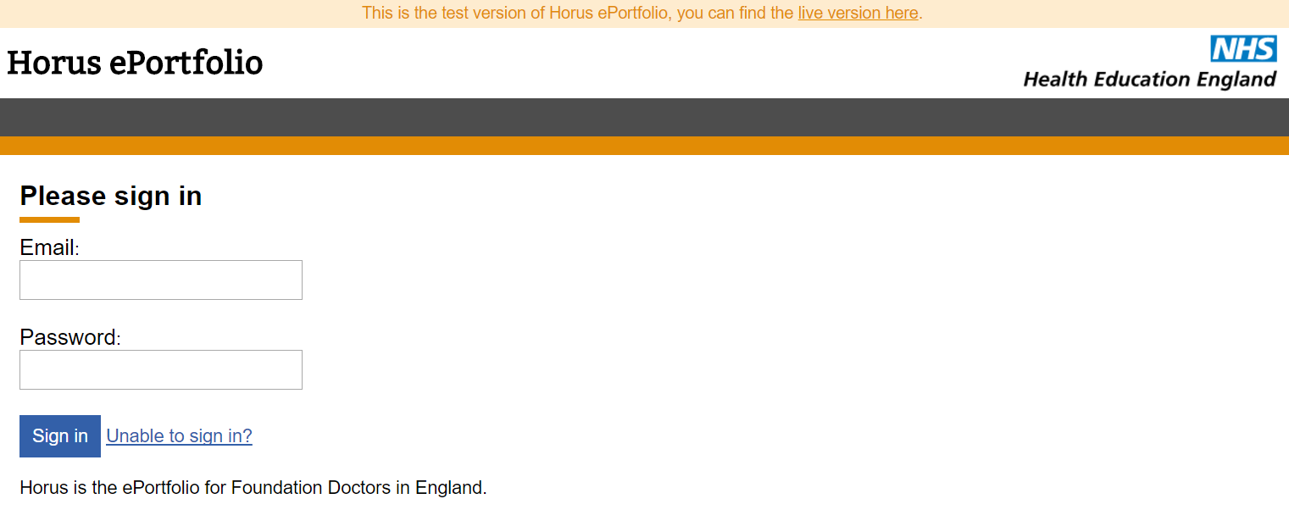
The Demonstration
Enquiries.Horus@hee.nhs.uk

Slide 15
Additional evidence of achievement forms
Course / seminar / other learning attended
Exam
Extra-curricular achievement
Interesting Case
Procedure (non-core)
Publication
Quality Improvement
Research
Taster
Teaching others
You will attach external documents to these forms
Enquiries.Horus@hee.nhs.uk

Slide 16
Functionality on its way
The FD portfolio will be switched on on Monday 24 July 2017
ARCP will be available from the end of August 2017
Portfolio download (coming in 2018)
Enquiries.Horus@hee.nhs.uk

Slide 17
Accounts and access
2017-18 F1 and F2 accounts have been created and many of you should have had a chance to activate your account
Majority of supervisor accounts have been created
A number of trainers will need to be created manually by FDs as they request SLE and Core Procedure validation (process will be clearly sign-posted)
Enquiries.Horus@hee.nhs.uk

Slide 18
Information from NES ePortfolio
Will be
  accessed through a new, read-only, portal
  accessible by all who currently have access to NES ePortfolio
  held securely by HEE
  removed from NES ePortfolio on 2 August 2017
Will not be
  imported into Horus
  lost or deleted by HEE
Enquiries.Horus@hee.nhs.uk

Slide 19
Support routes
Support site https://supporthorus.hee.nhs.uk
  FAQs
  User guides
  Video tutorials
  Webinar recordings
Local postgraduate centre admin team
Helpdesk
Enquiries.Horus@hee.nhs.uk

Slide 20
Feedback
When we finish this webinar you will all be presented with a short feedback survey
A link will also be in the follow up email (which will be sent 2 hours after the webinar)
We would appreciate your honest and constructive feedback
Enquiries.Horus@hee.nhs.uk

Slide 21
Important links
Horus ePortfolio
https://horus.hee.nhs.uk
Horus ePortfolio support site
https://supporthorus.hee.nhs.uk
Any suggestions or other feedback
Enquiries.Horus@hee.nhs.uk
Enquiries.Horus@hee.nhs.uk

