Slide 1



Horus ePortfolio for
Foundation
Familiarisation for supervisors - webinar
http://supporthorus.hee.nhs.uk
** Please put your microphone on mute! **

Slide 2

Introductions
Webinar lead
Kata Várnai
Project Manager (HEE e-portfolios)
Webinar support
Ben Aspinall and Jack Grice
Horus ePortfolio Administrators
Enquiries.Horus@hee.nhs.uk

Slide 3
Intended Audience
Clinical supervisors
Educational supervisors
Academic supervisors
Trainers completing Supervised Learning Events/Core Procedures with foundation doctors
Postgraduate centre administrators
Foundation programme directors
Anyone can attend, although it will be most useful for those who have direct responsibility for supervising foundation doctors and administrators providing support for supervisors
Enquiries.Horus@hee.nhs.uk

Slide 4

Aims
Familiarise supervisors and trainers with the main areas of Horus
Show supervisors how to create content and check foundation doctor e-portfolios
Show trainers how to validate forms by email
Create a training resource for cascaded training
Webinar will be recorded
Link will be circulated
Enquiries.Horus@hee.nhs.uk

Slide 5

Disclaimer
Horus is still under construction
What you see now is only part of all the features that will be available when it goes live
Horus will remain a living
product – we will continue
to develop and improve it
Enquiries.Horus@hee.nhs.uk

Slide 6
The Foundation e-portfolio
“The e-portfolio is a record of a trainee doctor’s progress and development through the foundation years. Successful completion of the curriculum requires doctors in training to record evidence of progressive attainment across all 20 ‘foundation professional capabilities’ (foundation programme training outcomes) in their e-portfolio. The e-portfolio is also the means by which trainers and supervisors record feedback and assessments on their trainees.” FPC 2016 p.5
The requirements have not changed
Enquiries.Horus@hee.nhs.uk

Slide 7
Webinar Style
Demonstration
Ask questions by typing in the chat box
  Please do not speak into your microphone during the webinar
Jack and Ben will answer questions in the chat box
I will stop periodically to answer your questions out loud
Enquiries.Horus@hee.nhs.uk

Slide 8
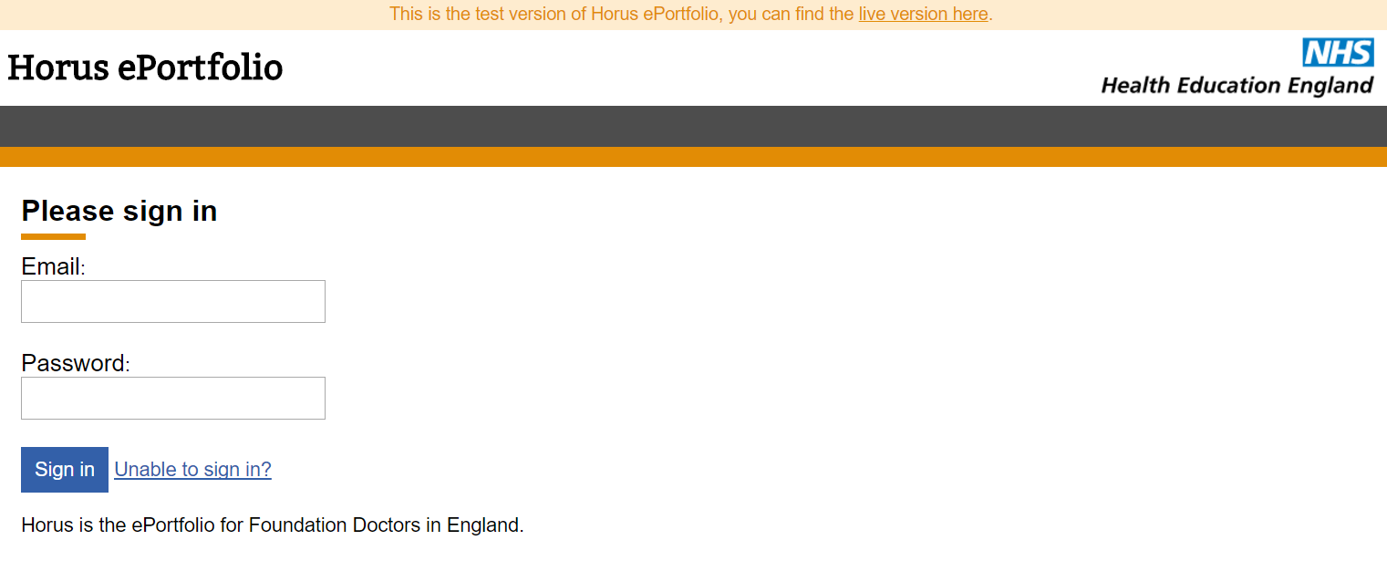
The Demonstration
Enquiries.Horus@hee.nhs.uk

Slide 9
Additional evidence of achievement forms
Course / seminar / other learning attended
Exam
Extra-curricular achievement
Interesting Case
Procedure (non-core)
Quality Improvement
Research
Taster
Teaching others
Enquiries.Horus@hee.nhs.uk

Slide 10
Other functionality on its way
More portfolio pages
  e.g. updated curriculum view
  e.g. working certificates section
ARCP
More overviews
Portfolio download (coming in 2018)
Enquiries.Horus@hee.nhs.uk

Slide 11
Accounts and access
All 2017-18 F1 and F2 accounts have now been created
A large number of supervisor accounts have been imported from the NES ePortfolio
A number will need to be created manually by local administrators
Local administrators are in the process of linking supervisors with foundation doctor placements
Supervisors will receive their account activation email mid-July 2017
Enquiries.Horus@hee.nhs.uk

Slide 12
Support routes
Support site http://supporthorus.hee.nhs.uk
  FAQs
  User guides
  Video tutorials
  Webinar recordings
Local postgraduate centre admin team
Helpdesk
Enquiries.Horus@hee.nhs.uk

Slide 13
Feedback
When I finish this webinar you will all be presented with a short feedback survey.
A link will also be in the follow up email (which will be sent 1 hour after the webinar)
We would appreciate your honest and constructive feedback.
Enquiries.Horus@hee.nhs.uk

Slide 14
Important links
Horus ePortfolio – training site
https://hee-horus-test-web.azurewebsites.net/login
Horus ePortfolio support site
http://supporthorus.hee.nhs.uk
Horus ePortfolio information web page https://www.nwpgmd.nhs.uk/horus-eportfolio-foundation-training-england
Any suggestions or other feedback
Enquiries.Horus@hee.nhs.uk
Enquiries.Horus@hee.nhs.uk

