Slide 1



Horus ePortfolio for
Foundation
Training for administrators - webinar
https://www.nwpgmd.nhs.uk/horus-eportfolio-foundation-training-england
** Please put your microphone on mute! **

Slide 2

Introductions
Webinar lead
Kata Várnai
Project Manager (HEE e-portfolios)
Webinar support
Ben Aspinall and Jack Grice
Horus ePortfolio Administrators
Enquiries.Horus@hee.nhs,uk

Slide 3
Intended Audience
Postgraduate centre administrators
Foundation programme directors
Foundation school administrators
Foundation school managers
Foundation school directors
Anyone can attend, although it will be most useful for those who have some direct responsibility for undertaking administrative tasks on Horus as well as supporting local users
Enquiries.Horus@hee.nhs,uk

Slide 4

Aims
Train those not able to attend regional workshops (March-April 2017)
Help refresh memories of those who attended regional workshops
Create a training resource for cascaded training
Webinar will be recorded
Link will be circulated
Enquiries.Horus@hee.nhs,uk

Slide 5

Outcomes
Familiarise you with the layout of Horus
Take you through the common tasks you would perform as an administrator
Show you how Horus looks to other types of users
Give you a chance to ask questions
Prepare you to cascade training locally
Explain how you can
share your feedback
Enquiries.Horus@hee.nhs,uk

Slide 6

Disclaimer
Horus is still under construction
What you see now is only part of all the features that will be available when it goes live
Horus will remain a living
product – we will continue
to develop and improve it
Enquiries.Horus@hee.nhs,uk

Slide 7
Webinar Style
Demonstration
Ask questions by typing in the chat box
  Please do not speak into your microphone during the webinar
Jack and Ben will answer questions in the chat box
I will stop periodically to answer your questions out loud
Enquiries.Horus@hee.nhs,uk

Slide 8
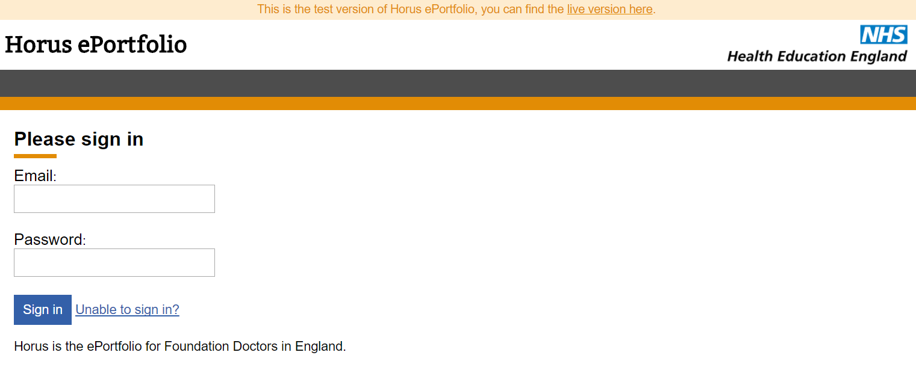
The Demonstration
Enquiries.Horus@hee.nhs,uk

Slide 9
FAQs
How to search for anyone on the system / add permissions to someone not in your location
Sending forms for approval
  Who can be added as approver
‘Attention items’
Uploading external documents
‘Moving’ forms between placements
Password reminder/reset
Back navigation
What can trainers see (permissions)
Current users in NES eP
Current F1 info in NES eP
Test site availability
Enquiries.Horus@hee.nhs,uk

Slide 10
Additional evidence of achievement forms
Course / seminar / other learning attended
Exam
Extra-curricular achievement
Procedure (non-core)
Quality Improvement
Research
Taster
Teaching others
Enquiries.Horus@hee.nhs,uk

Slide 11
Other functionality on its way – by July 2017
More portfolio pages
  e.g. updated curriculum view
  e.g. working certificates section
ARCP
More overviews
Portfolio download (coming in 2018)
Enquiries.Horus@hee.nhs,uk

Slide 12
Support routes
Helpdesk
Support site support.horus.hee.uk
  User guides
  Video tutorials
Webinars – trainers in June, foundation doctors in July
Local HEE foundation team
Enquiries.Horus@hee.nhs,uk

Slide 13
Feedback
Please complete a brief anonymous feedback form to help us improve these sessions:
https://henw.onlinesurveys.ac.uk/horus-webinar-admin-may-2017-feedback-form
Enquiries.Horus@hee.nhs,uk

Slide 14
Important links
Horus ePortfolio – training site
https://hee-horus-test-web.azurewebsites.net/login
Horus ePortfolio support site
support.horus.hee.uk
Horus ePortfolio open-access web page https://www.nwpgmd.nhs.uk/horus-eportfolio-foundation-training-england
Any suggestions or other feedback
Enquiries.Horus@hee.nhs.uk
Enquiries.Horus@hee.nhs,uk

